Slide 1

PROJECT
PRESENTATION

Slide 2
The three projects I’ll be presenting are:
Farm2Home,
Fake News Detection System,
Video Deduplication System.

Slide 3

PROJECT 1: Farm2Home
Overview:
Farm2Home is all about connecting farmers and families directly. Instead of relying on middlemen who often take a big share of profits, this platform gives farmers the chance to sell their fresh produce straight to consumers.
For farmers: It means fair prices, more control over their business, and recognition for their hard work.
For consumers: It means access to fresh, locally sourced products at reasonable prices, while also supporting the people who grow their food.
For communities: It builds trust, strengthens local economies, and encourages healthier eating habits.
->Many farmers are not familiar with digital tools. How can they add their products to Farm2Home?
Farm2Home makes it simple by working with NGOs, cooperatives, and volunteers who help farmers create listings and manage profiles. The platform is designed to be easy to use with local language support, and farmers can also share product details offline through forms or SMS, which support staff upload on their behalf. This ensures every farmer can participate fairly, regardless of technical skills.

Slide 4


Tech Stack & Role
Java: Used for backend logic and building APIs.
Spring Boot: Framework to simplify web application development, providing REST API support and dependency injection.
Maven: Build automation and dependency management tool handles libraries, compiles code, and packages the project.
MySQL: Relational database to store product details, inventory, and user information.
Spring Data JPA: For easy database integration and CRUD operations without writing complex SQL.
Thymeleaf : Template engine for rendering dynamic web pages directly from Spring Boot.

Slide 5
Tech Stack & Role
Built backend APIs for product listing, inventory, and price tracking.
Designed and connected database tables for products, inventory, and users.
Developed modules end-to-end:
Product module: Farmers can add or update products and manage prices.
Inventory module: Tracks stock, gives low-stock alerts, and hides products
when out of stock.

Slide 6
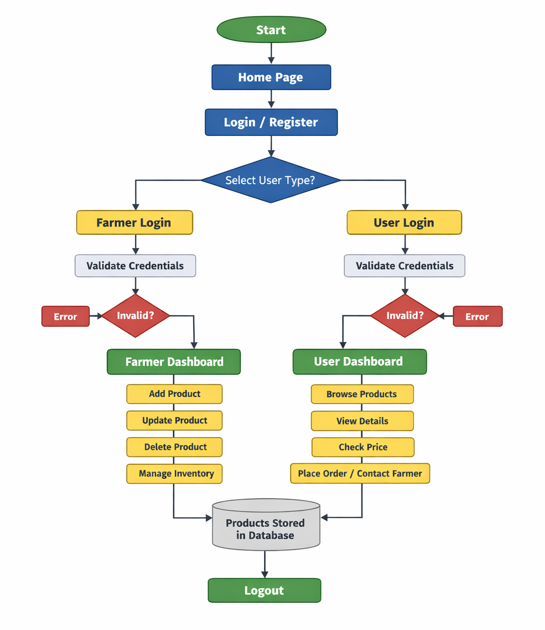
PROJECT 1: Farm2Home

Slide 7

PROJECT 2: Fake News Detection System
Overview:
Fake news spreads rapidly online, misleading people and damaging trust in society. Manual fact‑checking is too slow and cannot handle the huge amount of content shared every day. That’s why this project is important: it provides an automated system that uses NLP and machine learning to quickly analyze articles and classify them as Real or Fake. This makes fact‑checking faster, scalable, and reliable — helping reduce misinformation and ensuring people access trustworthy information.
Automated fake news detection: Classifies articles as Real or Fake.
NLP with TF‑IDF patterns: Identifies important words (e.g., “virus” vs. common words like “the”) for clearer results.
ML models (Logistic Regression, Naive Bayes): Trained on labeled datasets for accuracy.
Fast & scalable: Handles massive online content in real time.

Slide 8
Tech Stack & Role
Python: Chosen as the core language because it is easy to learn, widely used in ML, and has strong libraries for data science.
Datasets & Web Scraping: To gather large volumes of real and fake news articles from online sources like Kaggle to train and test the model.
NLTK / SpaCy: Used for Natural Language Processing tasks like cleaning text, tokenization, and removing stop‑words. This ensures the model focuses only on meaningful words.
Pandas & NumPy: Essential for handling large datasets and performing fast numerical operations during preprocessing.
Vectorization (BoW & TF‑IDF): Converts text into numerical features so ML models can understand it. TF‑IDF was chosen because it highlights important words (like “virus”) over common ones (like “the”), improving accuracy.
Scikit‑learn: Provides reliable ML algorithms (Logistic Regression, Naive Bayes) that are simple to implement and effective for text classification.
FastAPI: Used to integrate the trained model into a backend system, allowing real‑time predictions through APIs. It’s lightweight and fast, making deployment easier.

Slide 9
Tech Stack & Role
In this project, I contributed to both the machine learning model development and the frontend interface, making the system technically strong and user‑friendly. On the ML side, I helped build and evaluate models like Logistic Regression and Naive Bayes, which are well‑suited for text classification. My work involved cleaning and preprocessing raw news data, applying feature extraction techniques such as Bag of Words and TF‑IDF to highlight important words, and training the models on labeled datasets of real and fake news. I also tested and compared their performance using accuracy and precision metrics to ensure reliable predictions.
At the same time, I assisted in developing the frontend interface so the system could be easily used by anyone. I designed a simple input form where users can paste a news article URL, which is then sent to the backend (FastAPI) for analysis. The results are displayed clearly, showing whether the article is predicted as Real or Fake. This made the project more practical, turning the ML model into an interactive application rather than just backend code.
By working on both model building and frontend integration, I ensured the project not only had a strong technical foundation but also delivered a smooth experience for end users.

Slide 10
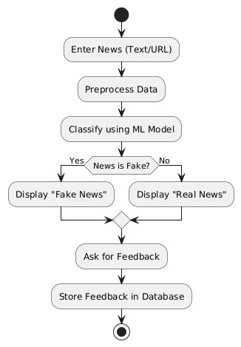

PROJECT 2: Fake News Detection System

Slide 11
PROJECT 3: Video Deduplication System
Overview:
The rapid growth of digital data, especially videos, has made cloud storage costly and space‑consuming, with duplicate uploads adding to the problem. To solve this, our project introduces a video deduplication system that automatically detects and removes duplicate or near‑duplicate videos. The system uses Convolutional Neural Networks (CNNs) to extract both global features (overall video patterns like color and frame structure) and local features (fine details such as edges and objects). By comparing these features, the system identifies duplicates quickly and ensures that only unique videos are stored. This approach makes cloud storage more efficient, accurate, and cost‑effective, helping platforms and users save space while managing data smarter.

Slide 12

Technologies Used
Pairwise Matching: Compares videos against each other to detect duplicates and near‑duplicates.
CNN‑based Feature Extraction (Conv2D):
Convolutional Neural Networks (CNNs) are excellent at capturing both global patterns (overall structure, colors) and local details (edges, textures, objects).
Conv2D layers process video frames to extract meaningful features beyond simple hashes.
Similarity Metrics:
Metrics like cosine similarity or Euclidean distance are used to measure how close two videos are in feature space.
This ensures even near‑duplicates are detected, not just exact copies.
Deep Learning Integration:
Deep learning models learn complex representations of video data, making the system more robust and accurate compared to traditional hashing.
Hashing (SHA‑256, MD5): Fast and lightweight for detecting exact duplicates.

Slide 13
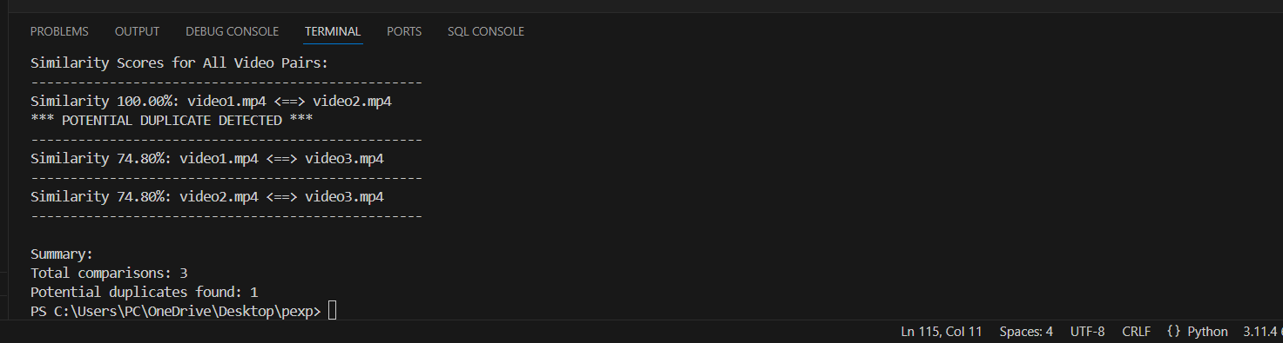
My Role:
I built the whole project from start to finish. My job was to make a system that can “look” at videos, understand their patterns, and decide if two videos are duplicates. I wrote the code to sample frames from each video, turn those frames into features, and then compare them using similarity checks. I also set up the logic so the system can automatically flag duplicates and give a clear summary of results.
In short, I wasn’t just working on one piece - I handled everything: choosing the right tools, writing the code, testing it, and making sure the system runs smoothly. My role was to bring all the technologies together and turn the idea into a working solution.

Slide 14
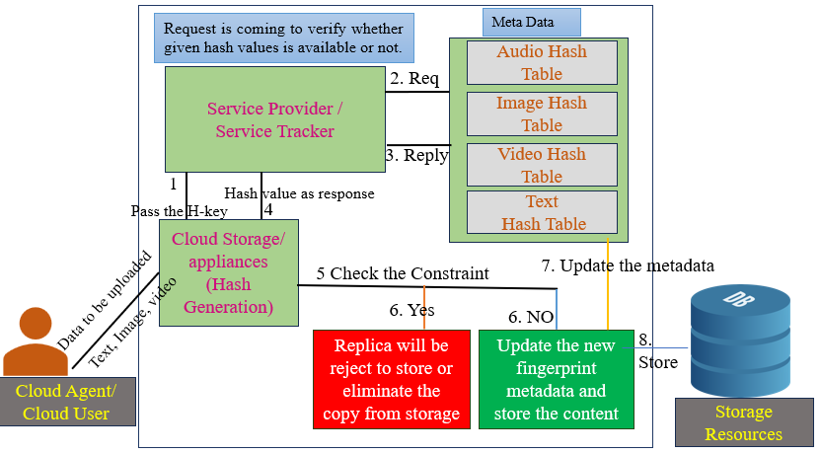
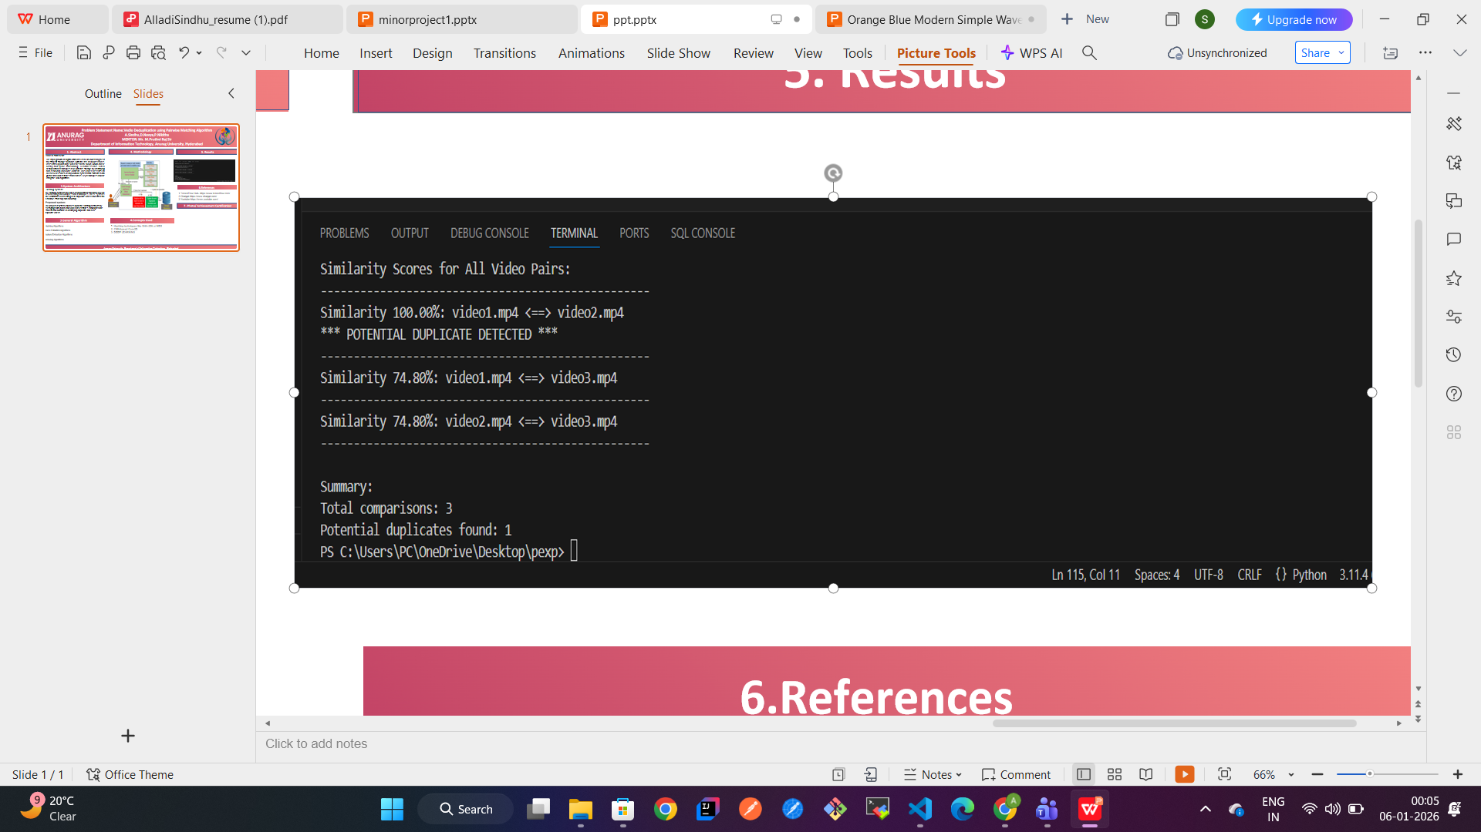
PROJECT 3: Video Deduplication System

Slide 15
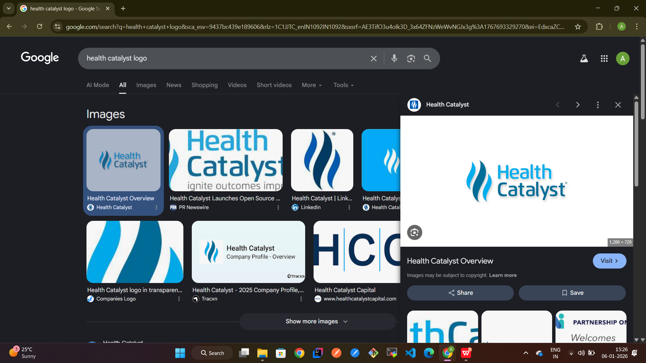
About Health Catalyst:
Health Catalyst is a healthcare technology company that helps hospitals and healthcare organizations make better decisions using data. In healthcare, a lot of data exists, but it is often scattered across different systems. Health Catalyst brings all this data together and turns it into clear insights that doctors, nurses, and hospital leaders can actually use.
The main goal of Health Catalyst is to improve patient care, reduce unnecessary costs, and help healthcare organizations work more efficiently.
Founded: 2008
Headquarters: South Jordan, Utah, USA
Industry: Healthcare data and analytics technology and services
What They Do?
-Combine clinical, financial, and operational data into a single, reliable platform
-Use analytics and AI to identify care gaps, reduce costs, and improve outcomes
-Support healthcare teams with both technology and expert guidance
-Focus on measurable improvements, not just reports or dashboards

Slide 16
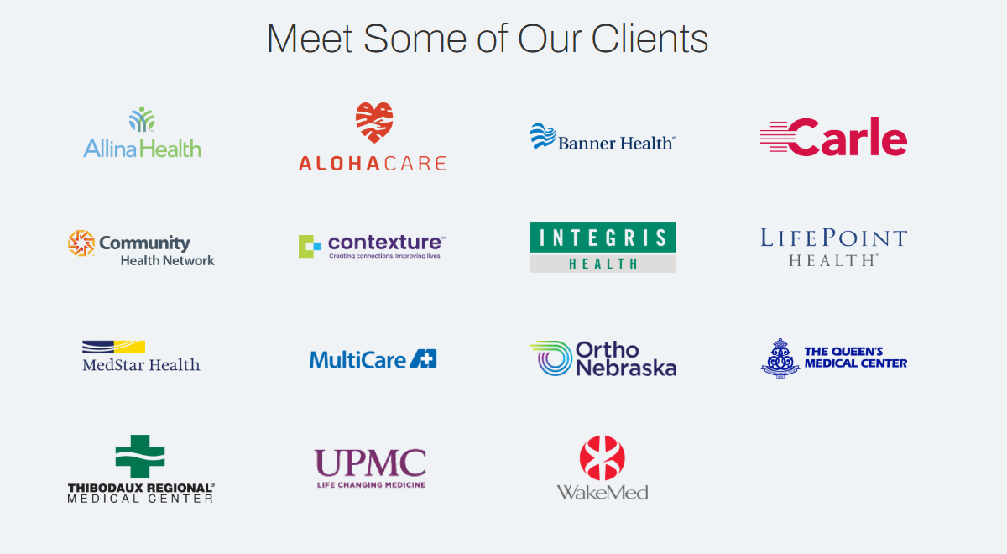
About Health Catalyst:
“Overall, Health Catalyst is focused on transforming healthcare by turning complex data into real improvements in patient care and outcomes.”

Slide 17
Thank You

